Slide 1
CUBIT™ Fast-Start Tutorial
1. Introduction

Slide 2
Contact Information
Bugs, enhancement requests:
support@coreform.com
Meshing Questions, CUBIT™ community:
Forum.Coreform.com
Website:
www.Coreform.com

Slide 3
Platforms
Windows (64 bit)
Linux (64 bit)
Mac OS/X (64 bit)

Slide 4
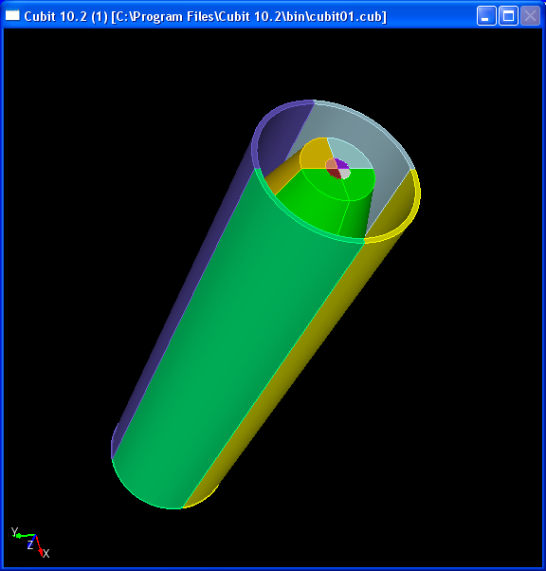
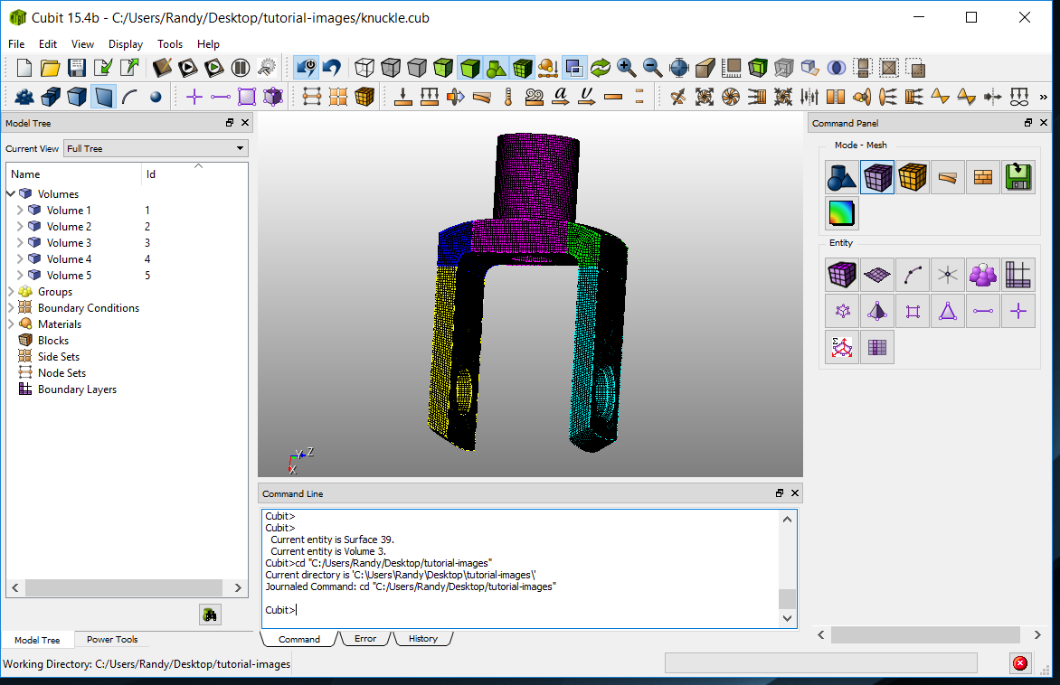
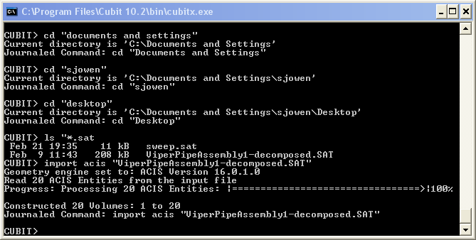
User Interfaces
Command Line
Graphical User Interface
Better Performance
Power Users
Harder to learn/use
Interactive, Intuitive
More tools available
Easy to learn/use

Slide 5
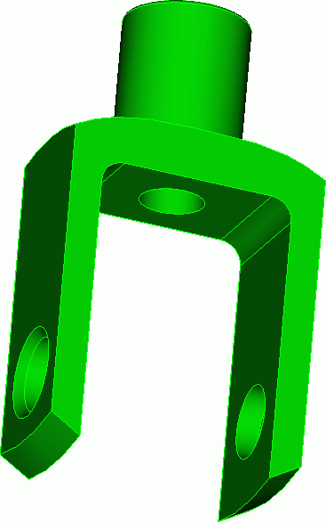
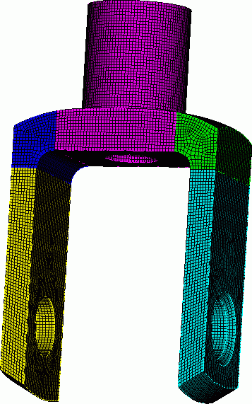
CAD Model
CUBIT™
Mesh

Slide 6
CAD Model
CUBIT™
Mesh
Meshing Tools
Geometry Creation
Geometry Preparation
Mesh Optimization
Boundary Conditions
Scripting
Automation

Slide 7
CAD Model
CUBIT™
Mesh
ACIS
STEP
IGES
Facets
STL
Exodus II
Meshing Tools
Geometry Creation
Geometry Preparation
Mesh Optimization
Boundary Conditions
Scripting
Automation

Slide 8
CAD Model
CUBIT™
Mesh
ACIS
STEP
IGES
Facets
STL
Exodus II
Meshing Tools
Geometry Creation
Geometry Preparation
Mesh Optimization
Boundary Conditions
Scripting
Automation
Exodus II
Abaqus
IDEAS-Universal
NASTRAN-BDF
Patran
LS-Dyna
Fluent

Slide 9
Entity Types in CUBIT™
Geometry Entities in CUBIT™
Mesh Entities, which approximate geometry entities of same dimension
Vertex
Curve
Surface
Volume
Body
Node
Edge
Face
Hex
Hex
Tri
Tet
CUBIT™ Meshes Vertices First, Then Curves, Then Surfaces, Then Volumes
(Advancing Front Paradigm)

Slide 10
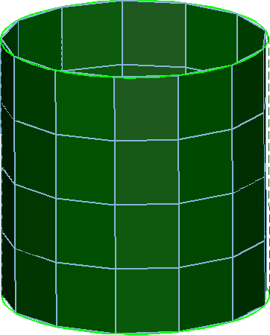
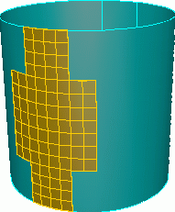
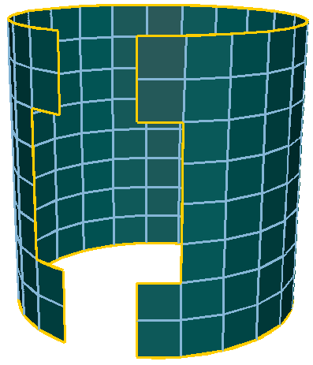
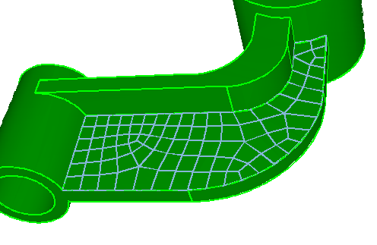
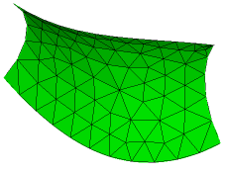
Meshing
Surface Meshing
Mapped
Sub-map
Pave
Trimesh

Slide 11
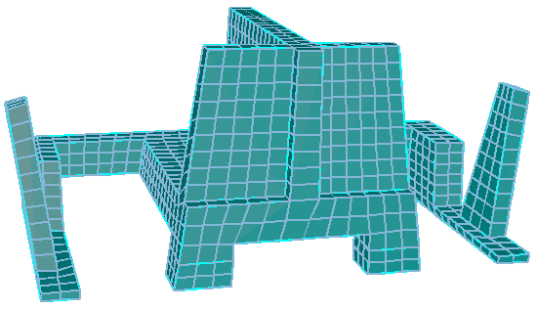
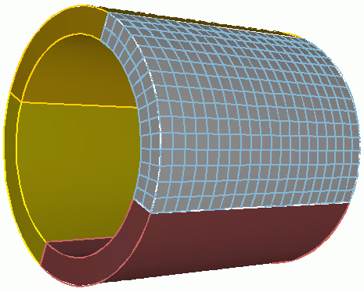
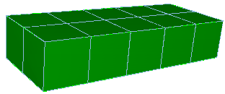
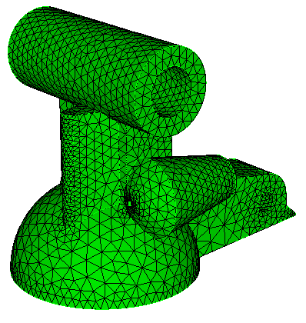
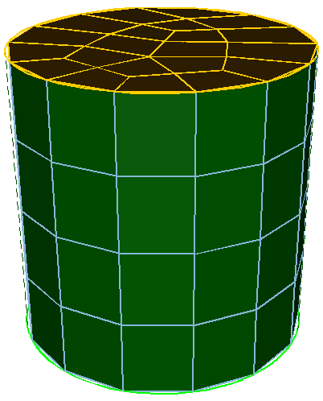
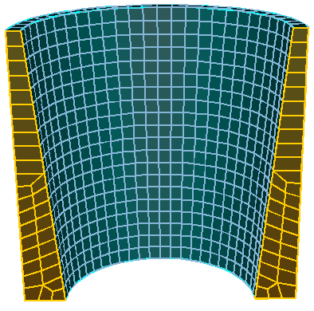
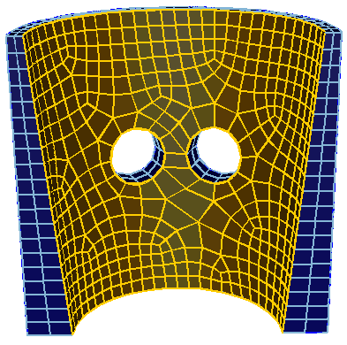
Meshing
Volume Meshing
Mapped
Sub-map
Sweep
Tetmesh

Slide 12
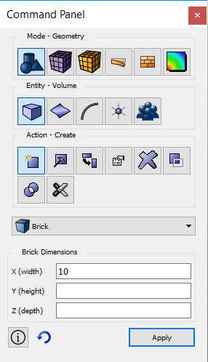
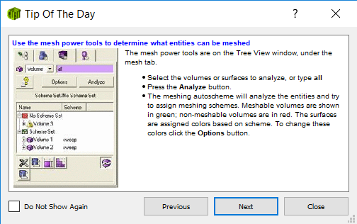
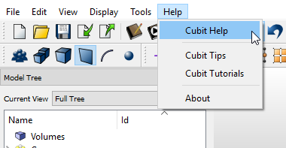
Online Help
CUBIT™ online help from
www.Coreform.com
Tip of the Day: Lots of valuable nuggets at CUBIT™ startup
User Documentation from the Help Menu (same as online help)
Command Panels: Help on specific command
support@coreform.com

